Slide 1
ELEC 4727/5727
Computer Vision & Image Processing
Lecture 3
Image Enhancement in Spatial Domain

Slide 2
Overview
Enhancement
Techniques
Spatial
Operates on pixels
Frequency Domain
Operates on FT of
Image

Slide 3
Spatial Domain Methods
In these methods, an operation (linear or non-linear) is performed on the pixels in the neighborhood of coordinate (x,y) in the input image F, giving enhanced image F’
Neighborhood can be any shape but generally it is rectangular
( e.g., 3x3, 5x5, 9x9 etc.)
g(x,y) = T[f(x,y)]

Slide 4
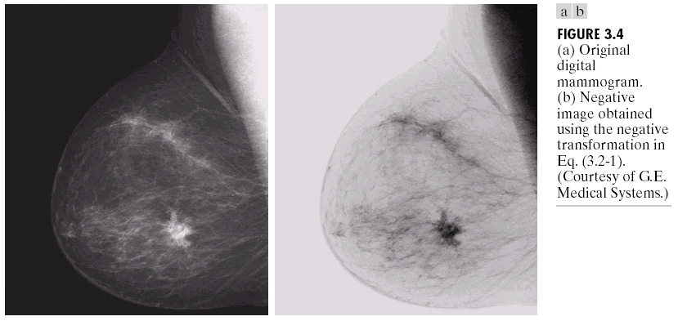
Image negative
Image Negative: s = L – 1 – r

Slide 5
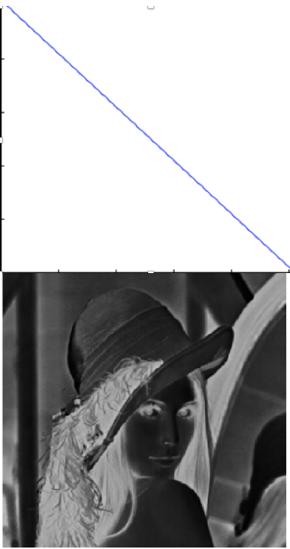
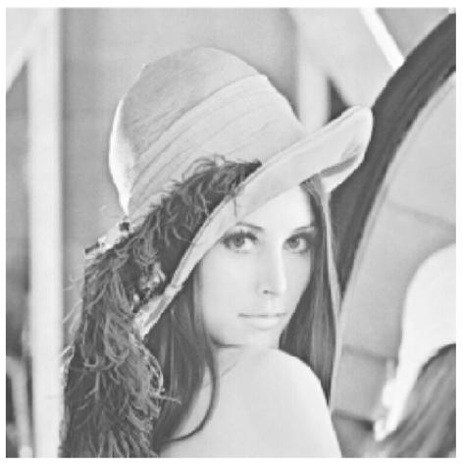
Image negative
Image Negative: s = L – 1 – r

Slide 6
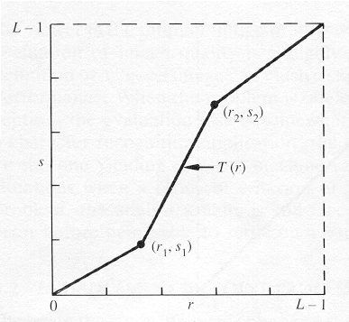
Contrast Stretching
To increase the dynamic range of the gray levels in the image being processed.

Slide 7
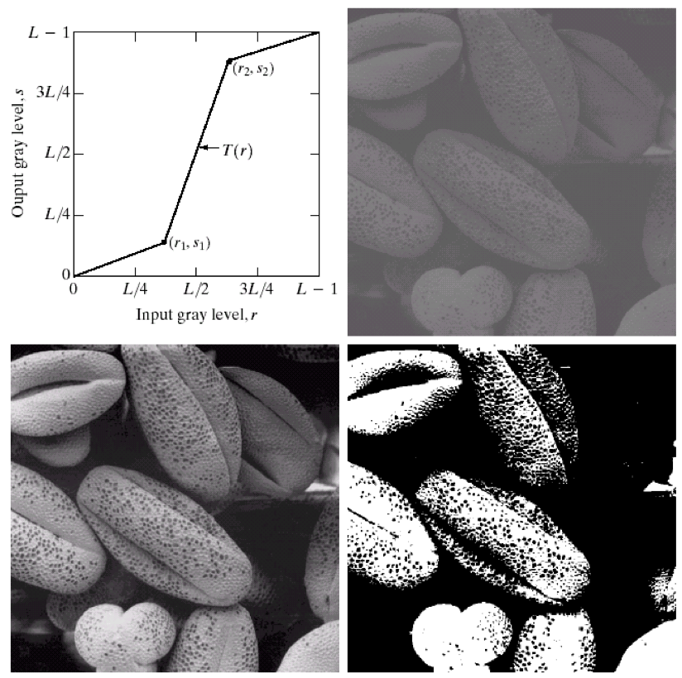
Contrast Stretching -- Example

Slide 8
Contrast Stretching -- Example
The locations of (r₁,s₁) and (r₂,s₂) control the shape of the transformation function.
If r₁= s₁ and r₂= s₂ the transformation is a linear function and produces no changes.
If r₁=r₂, s₁=0 and s₂=L-1, the transformation becomes a thresholding function that creates a binary image.
Intermediate values of (r₁,s₁) and (r₂,s₂) produce various degrees of spread in the gray levels of the output image, thus affecting its contrast.
Generally, r₁≤r₂ and s₁≤s₂ is assumed.

Slide 9
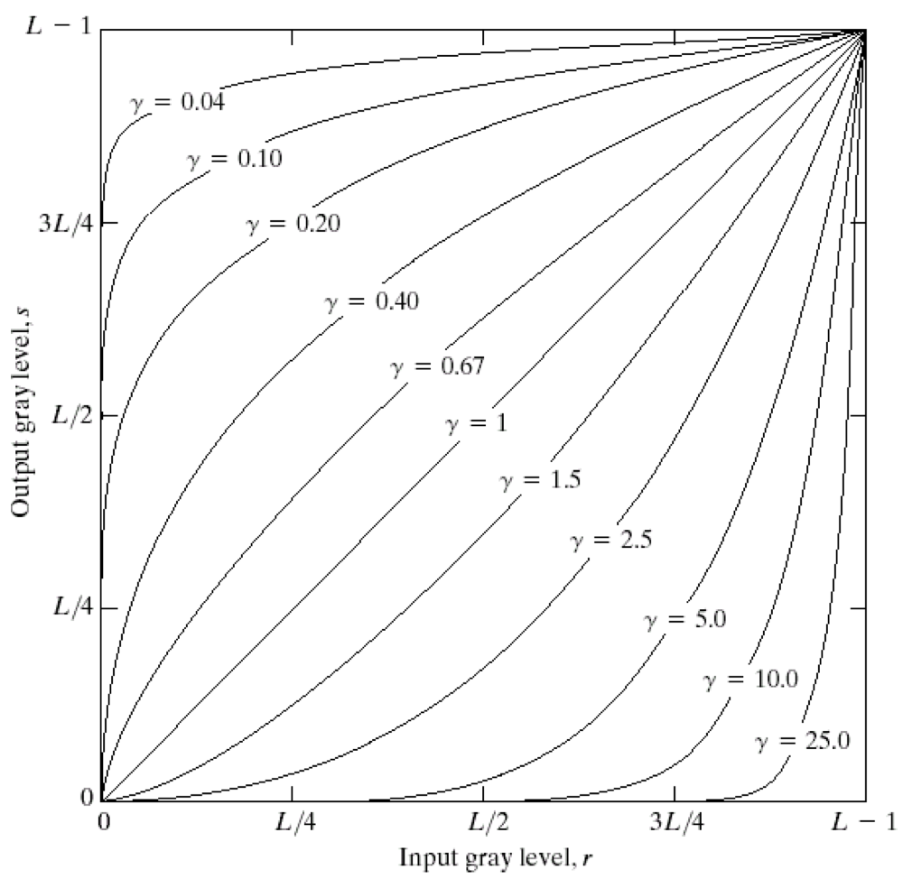
Power Law (Gamma) Transformation
s = cr^{γ}
c, γ : positive constants

Slide 10
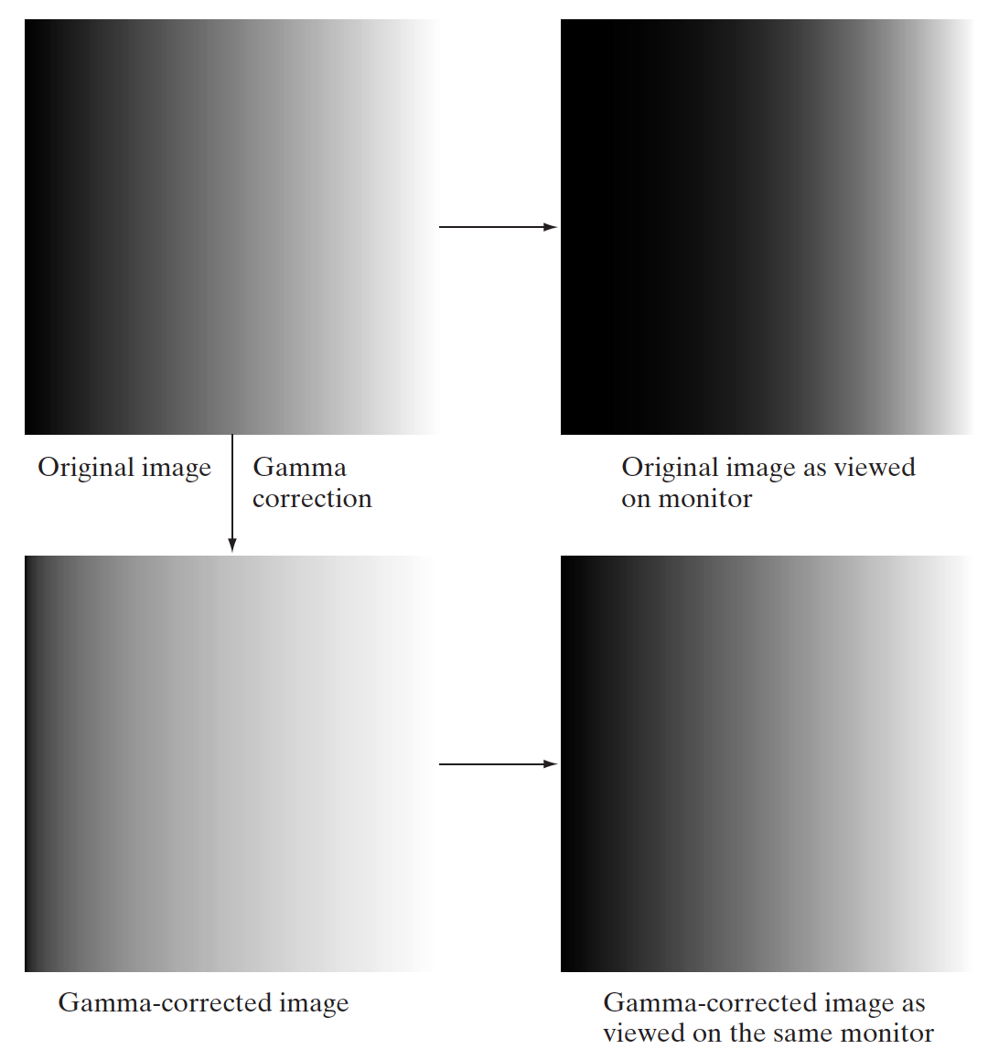
Power Law (Gamma) Transformation
Almost every computer monitor, from whatever manufacturer, has one thing in common. They all have a intensity to voltage response curve which is roughly a 2.5 power function.
The effect can be overcome by applying an end-to-end power function

Slide 11
Power Law (Gamma) Transformation
Gamma correction function is a function that maps luminance levels to compensate the non-linear luminance effect of display devices (or sync it to human perceptive bias on brightness).

Slide 12
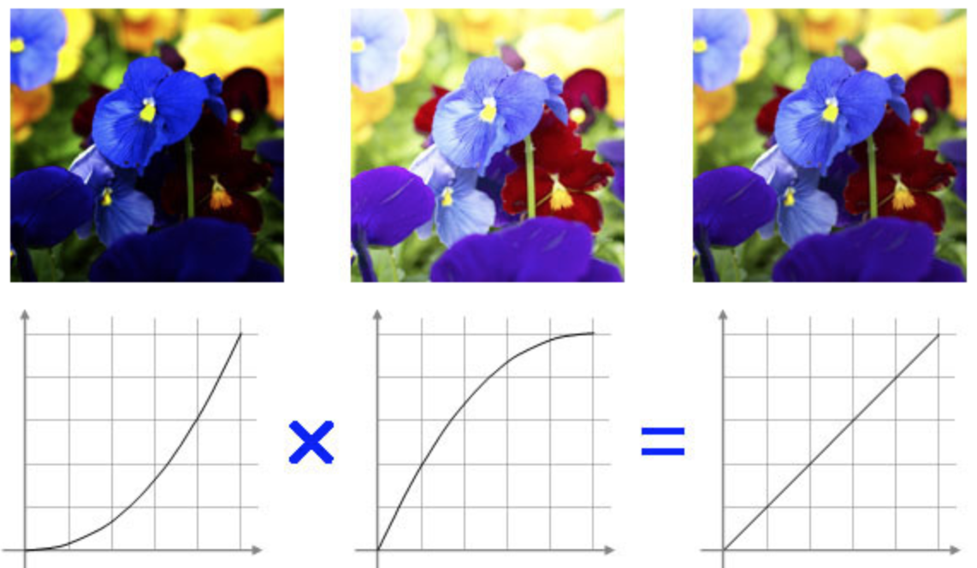
Power Law (Gamma) Transformation

Slide 13
Power Law (Gamma) Transformation
Camera
Display
Encoding gamma
Display gamma
Real Scene
Scene Radiation
Pixel Values
Pixel Values
Displayed
Radiation
Displayed Image
End-to-End-gamma = Encoding-gamma * Display gamma
The recommended value is 1.5 in a dark environment in a movie theater and 1.125 in a bright room.

Slide 14
Bit-Plane Slicing
To highlight the contribution made to the total image appearance by specific bits.
i.e. Assuming that each pixel is represented by 8 bits, the image is composed of 8 1-bit planes.
Plane 0 contains the least significant bit and plane 7 contains the most significant bit.
Only the higher order bits (top four) contain visually significant data. The other bit planes contribute the more subtle details.

Slide 15
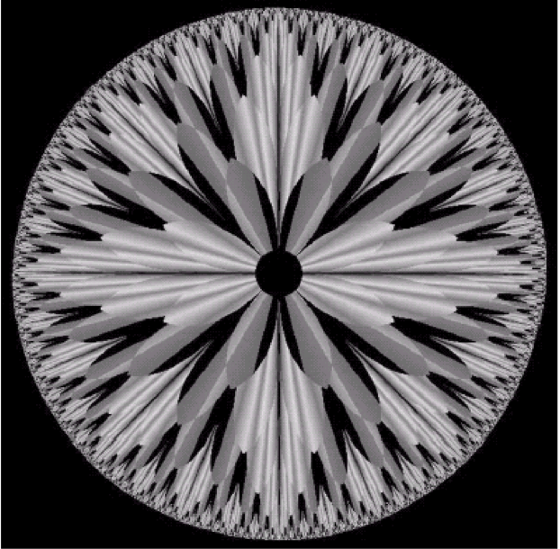
Bit-Plane Slicing

Slide 16
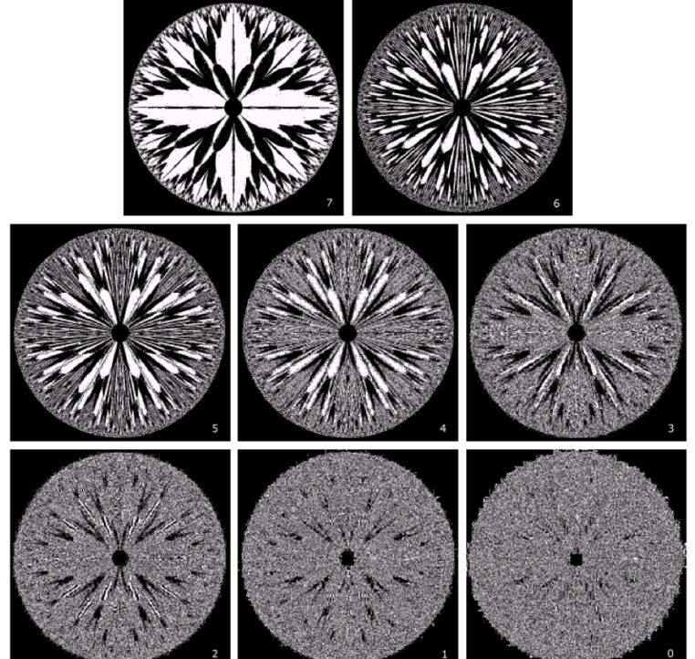
Bit-Plane Slicing

Slide 17
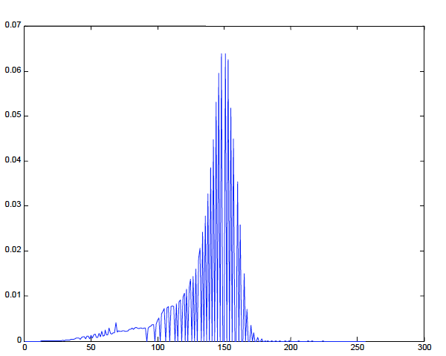
Histogram Processing

Slide 18
Histogram Processing
The histogram of a digital image with gray levels from 0 to L-1 is a discrete function h(r_{k})=n_{k}, where:
r_{k} is the kth gray level
n_{k} is the # pixels in the image with that gray level
n is the total number of pixels in the image
k = 0, 1, 2, …, L-1
Normalized histogram: p(r_{k})=n_{k}/n
sum of all components = 1

Slide 19
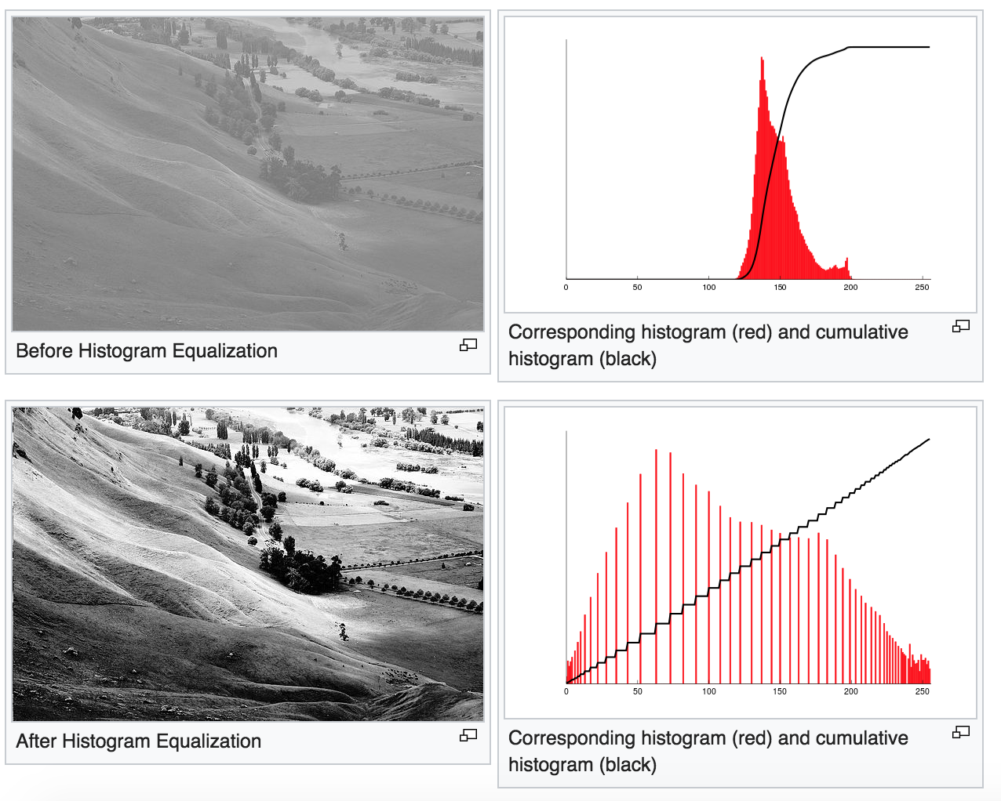
Histogram Processing

Slide 20
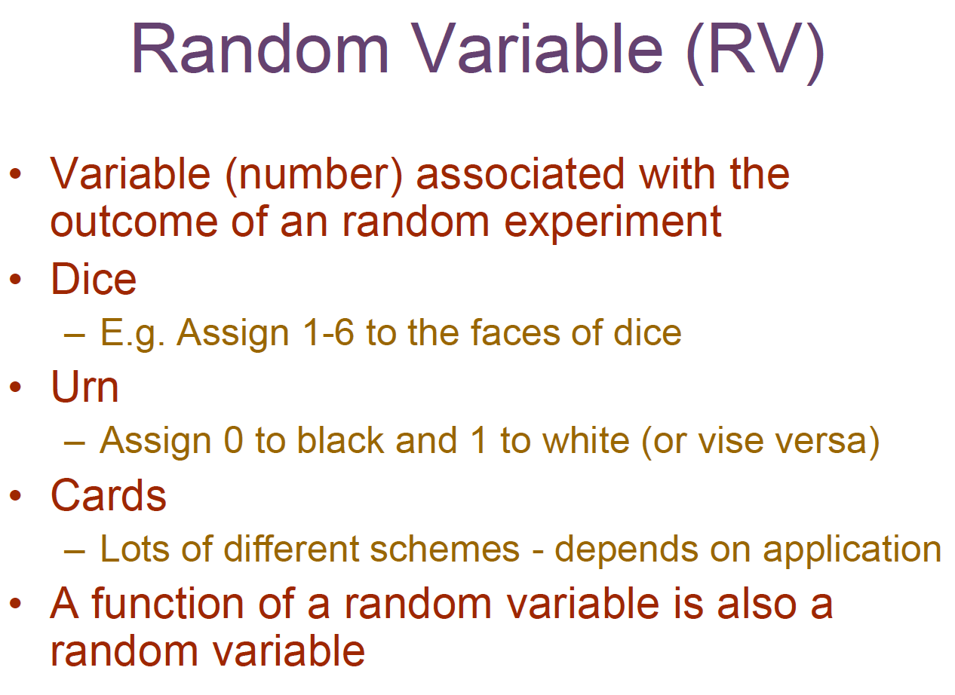
Histogram Processing

Slide 21
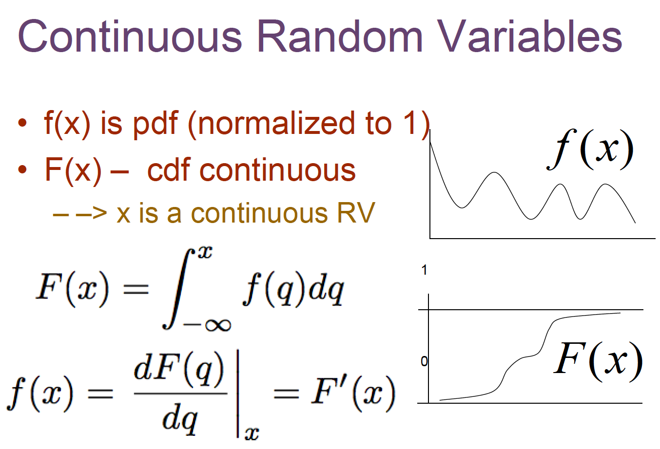
Histogram Processing

Slide 22
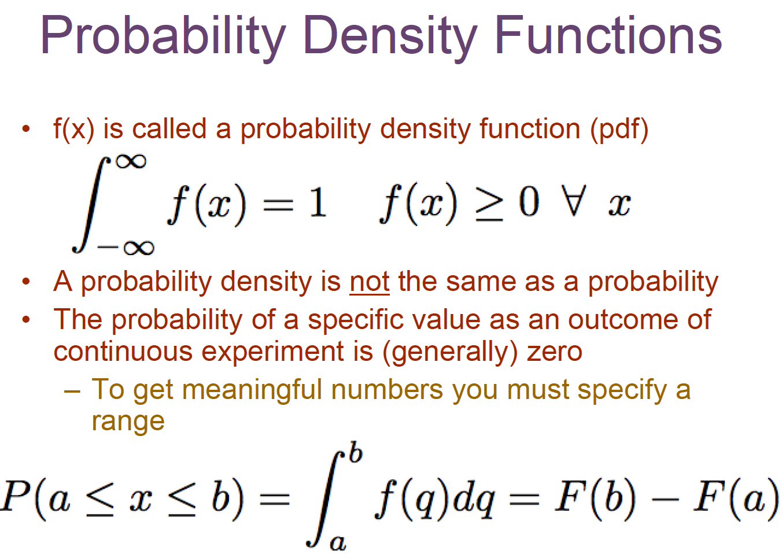
Histogram Processing

Slide 23
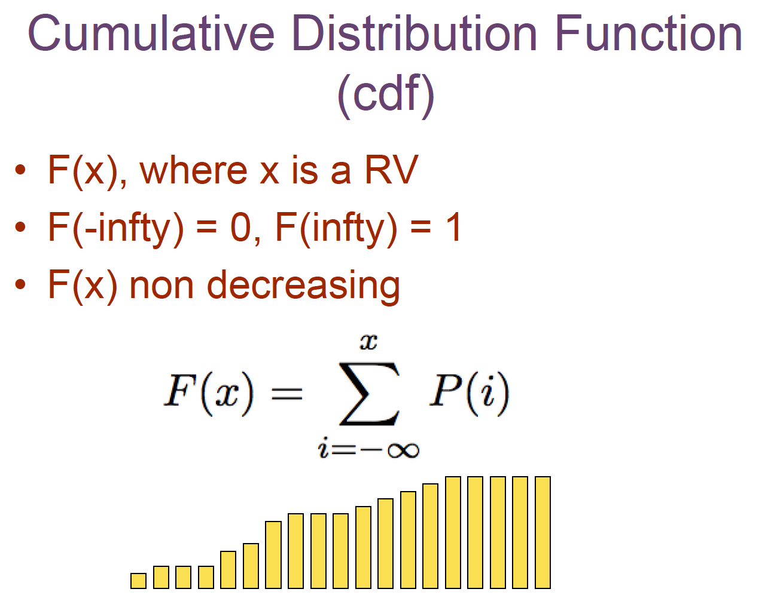
Histogram Processing

Slide 24
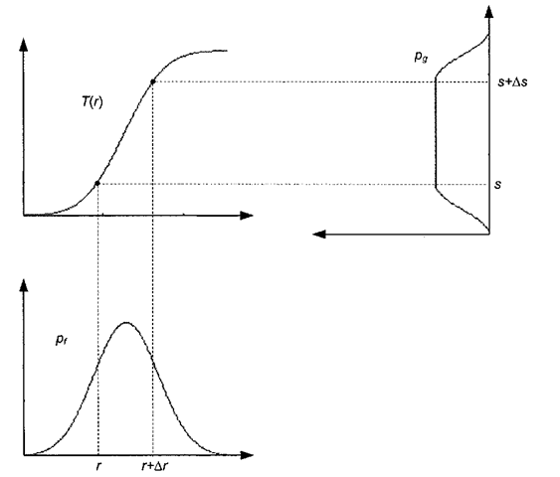
Histogram Equalization

Slide 25
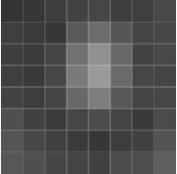
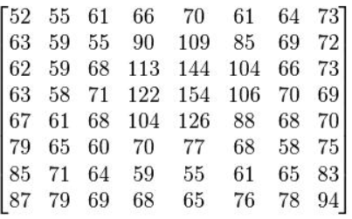
Histogram Equalization
size=8×8

Slide 26
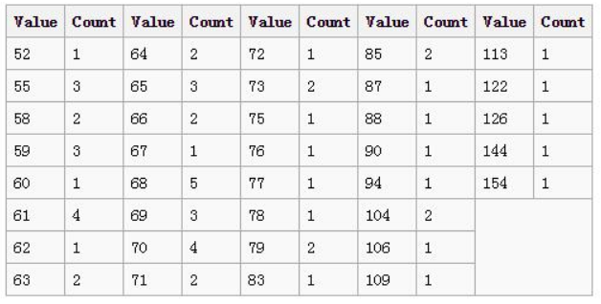
Histogram Equalization
First, calculate the histogram of the image

Slide 27
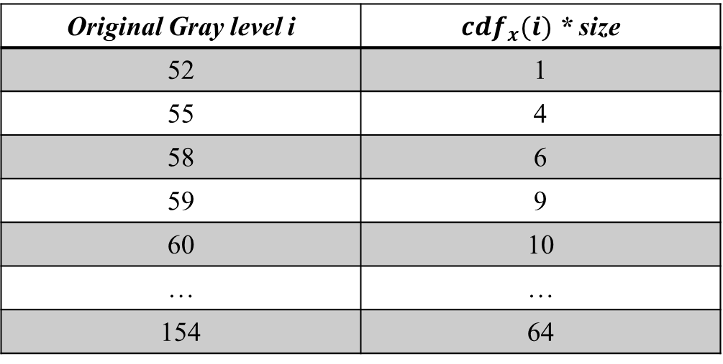
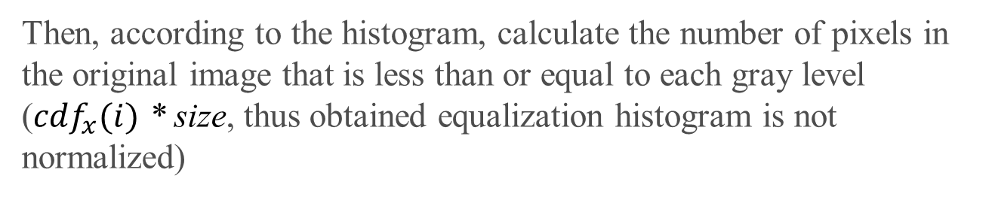
Histogram Equalization
Then, according to the histogram, calculate the number of pixels in the original image that is less than or equal to each gray level (${cdf}_{x}(i)$ * size, thus obtained equalization histogram is not normalized)
Original Gray level i | ${cdf}_{x}(i)$ * size
52 | 1
55 | 4
58 | 6
59 | 9
60 | 10
… | …
154 | 64

Slide 28
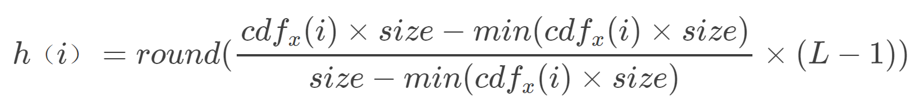
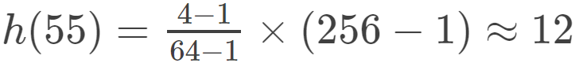
Histogram Equalization
Use the following equation to get the new gray level for each pixel
Taking the original gray level 55 as an example, the equalized gray level h:

Slide 29
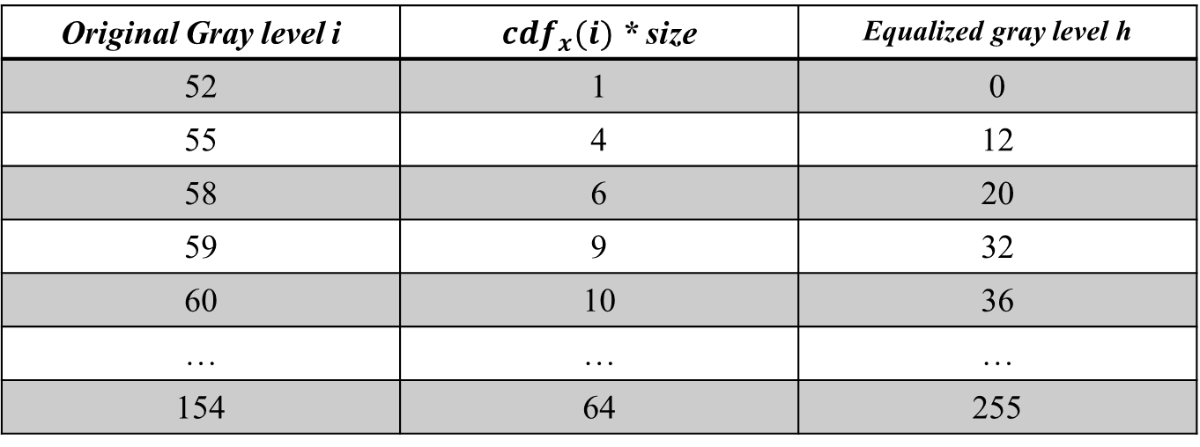
Histogram Equalization
Original Gray level i | ${cdf}_{x}(i)$ * size | Equalized gray level h
52 | 1 | 0
55 | 4 | 12
58 | 6 | 20
59 | 9 | 32
60 | 10 | 36
… | … | …
154 | 64 | 255

Slide 30
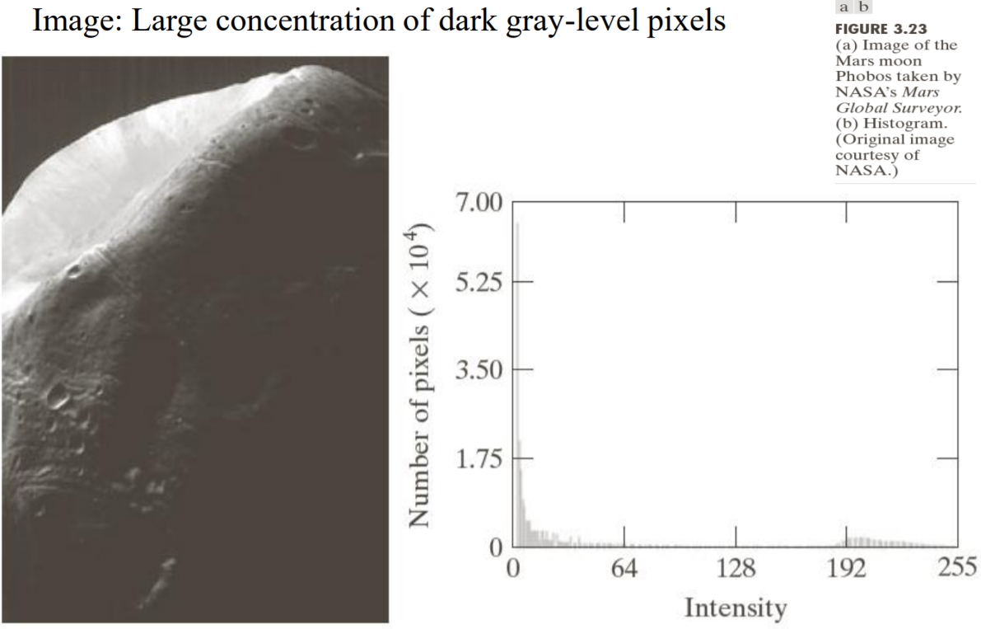
Problems with Histogram Equalization

Slide 31
Problems with Histogram Equalization

Slide 32
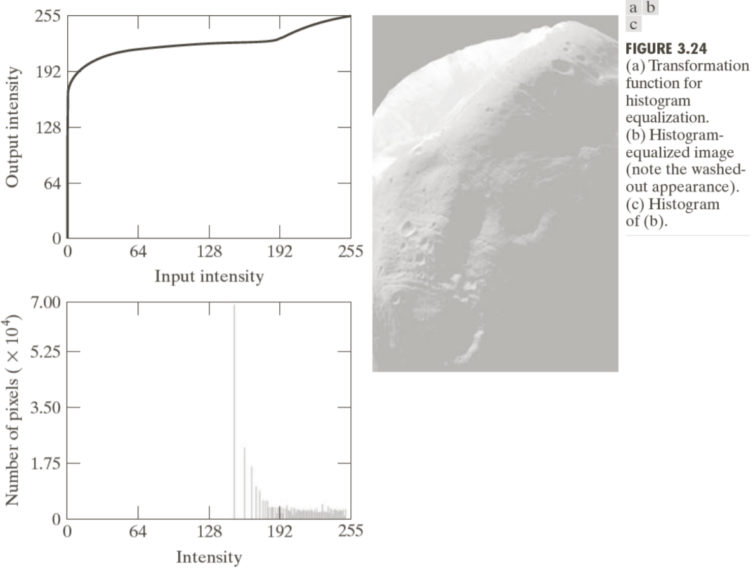
Problems with Histogram Equalization

Slide 33
Histogram Specification
Histogram equalization method:
Only generates one result: an image with approximately uniform histogram (without any flexibility)
Enhancement may not be achieved as desired
Histogram specification:
Transform an image according to a specified gray-level histogram
Includes
Specify particular histogram shapes (pz (z)) capable of highlighting certain gray-level ranges
Obtain the transformation function for transformation of r to z

Slide 34
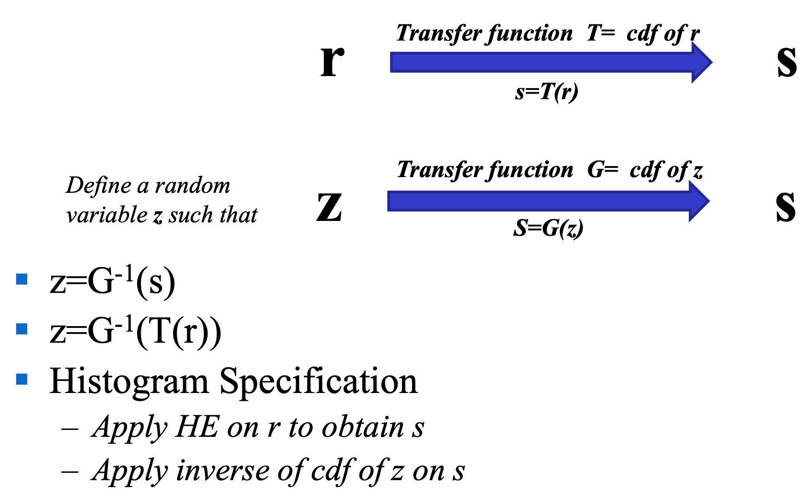
Histogram Specification

Slide 35
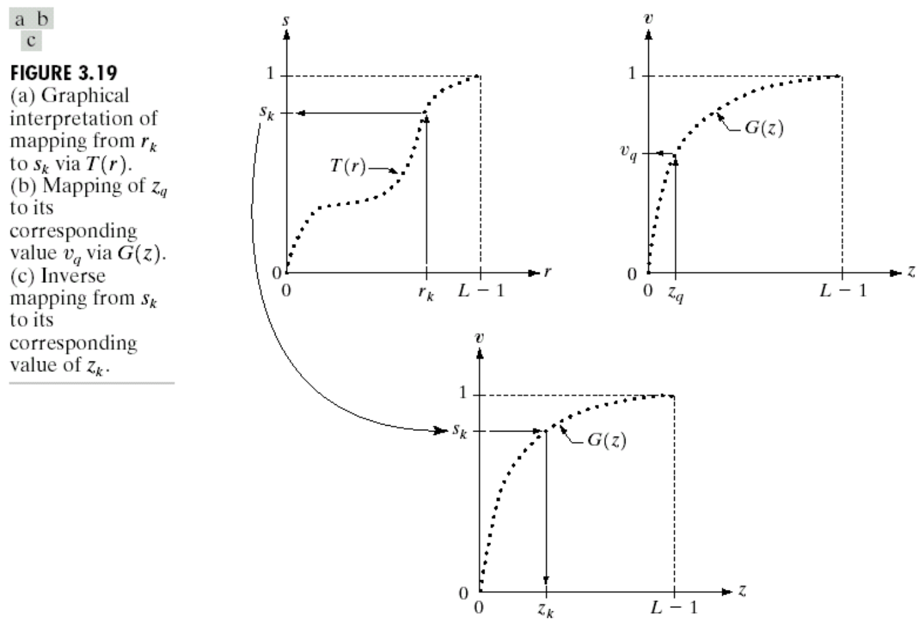
Histogram Specification
Step 1: Equalize the levels of the original image
Step 2: Specify the desired pdf and obtain the transformation function
Step 3: Apply the inverse transformation function to the levels obtained in step 1

Slide 36
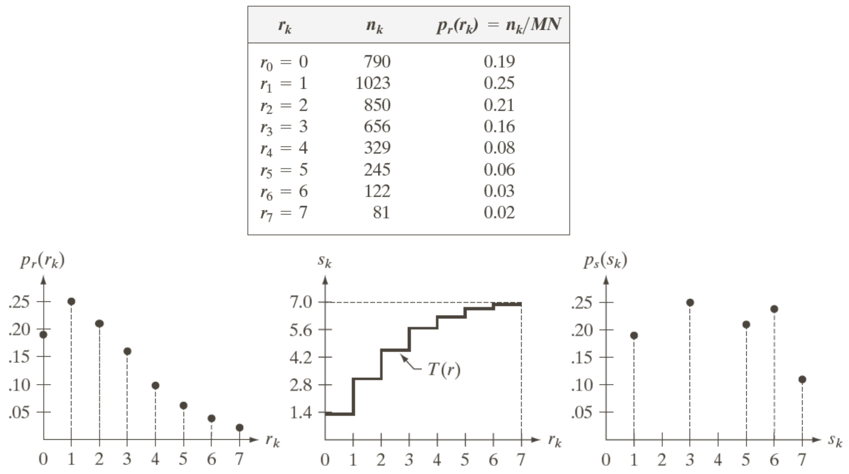
Step 1: Perform Histogram Equalization

Slide 37
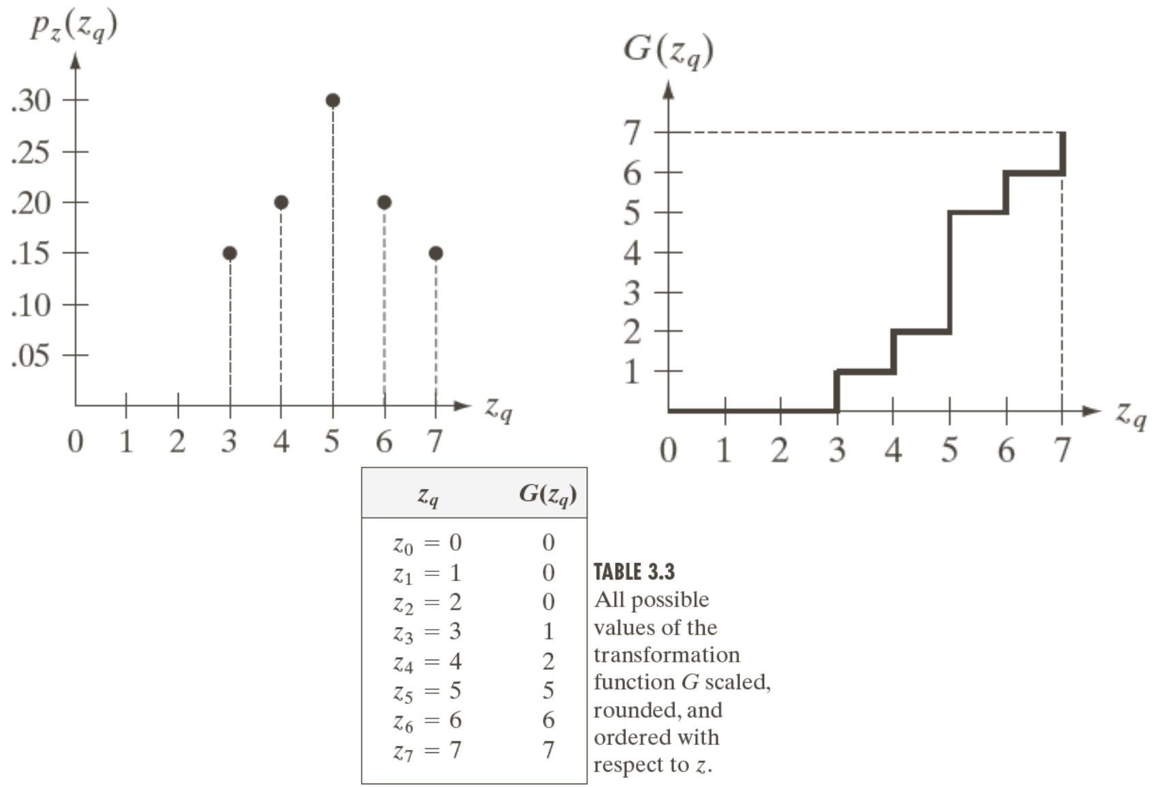
Step 2: Specify the Desired PDF and Get the CDF

Slide 38
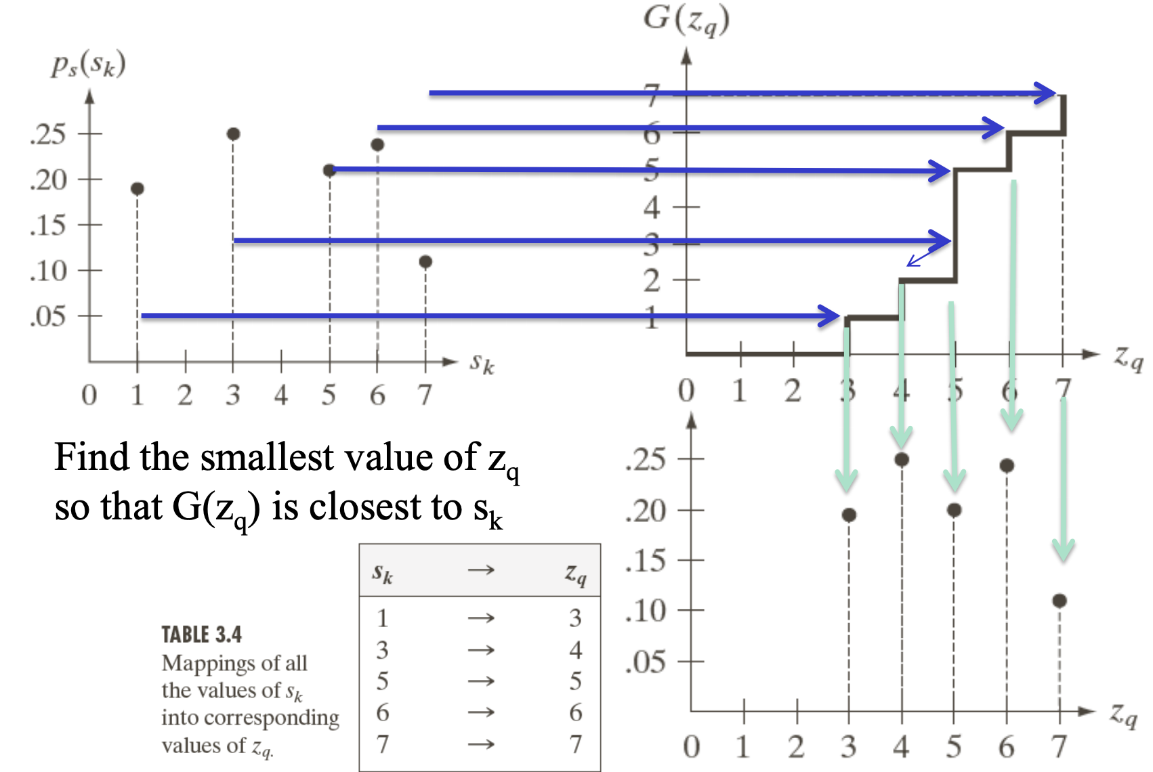
Step 3: Apply the Inverse PDF

Slide 39
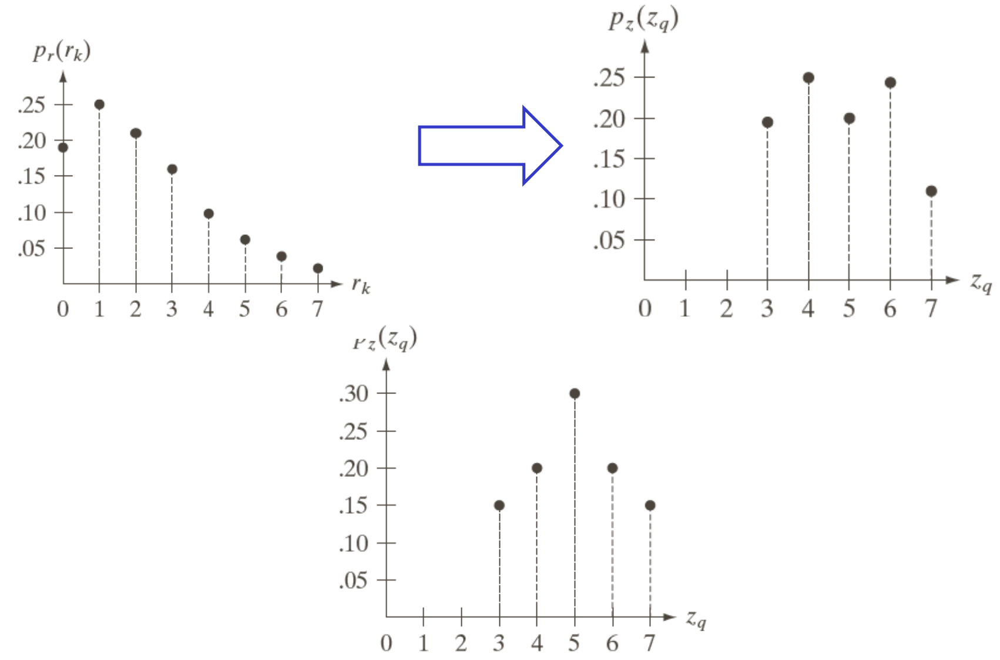
Histogram Specification

Slide 40
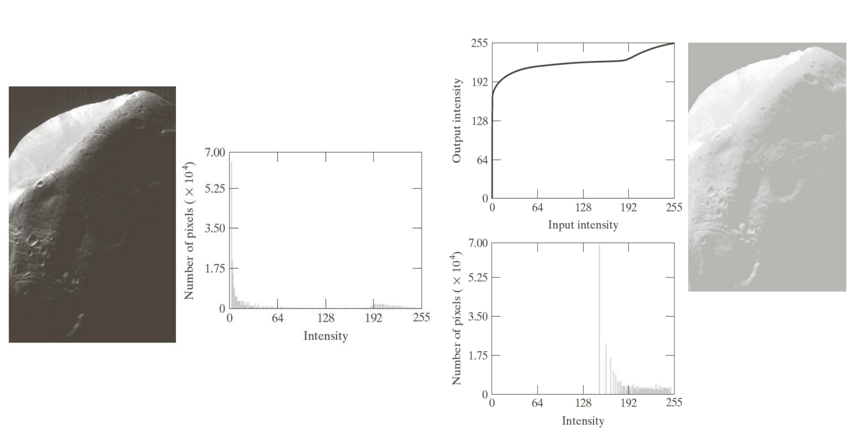
Histogram Specification Example

Slide 41
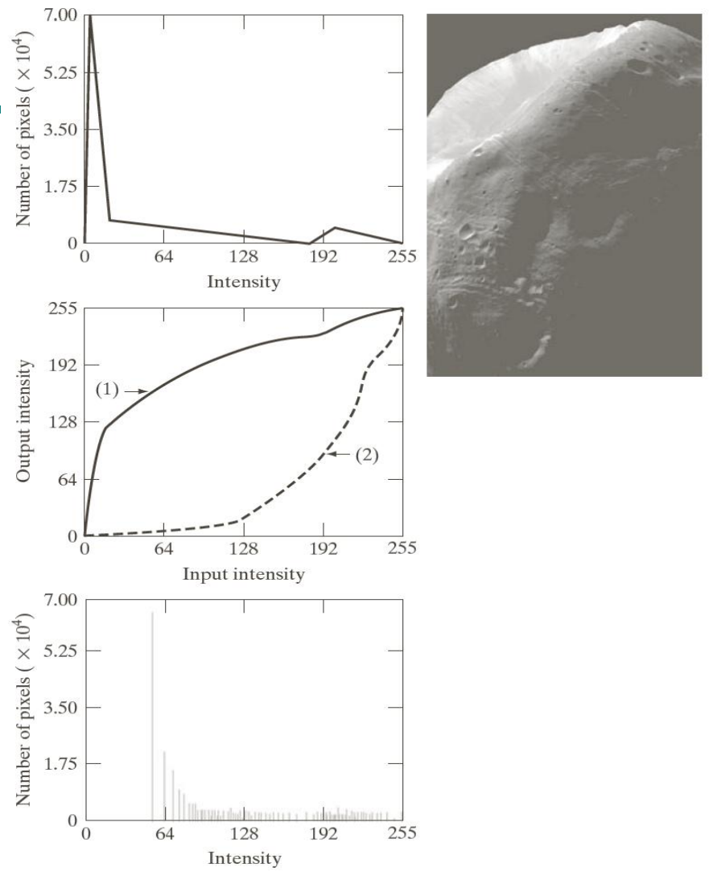

Slide 42
Histogram Specification
Issues with Histogram specification/matching:
– No rule for specifying an optimal histogram
– Each given enhancement task needs to be analyzed on a case-by-case basis
– Histogram specification is somehow a trial-and-error process

Slide 43
Local Histogram Processing
The histogram processing methods mentioned up to now are global transformation where:
Function is designed according to the gray-level distribution over an entire image
Global transformation methods may not be suitable for enhancing details over small areas
Where number of pixels in these small areas may have negligible influence on designing the global transformation function

Slide 44
Local Histogram Processing
To enhance details over small areas in an image
Procedure
Define a neighborhood (e.g. N8)
Move it from pixel to pixel.
For every pixel
• Histogram computed for the neighborhood
• Transfer function computed for HE or H Spec
• Applied on Centre Pixel

Slide 45
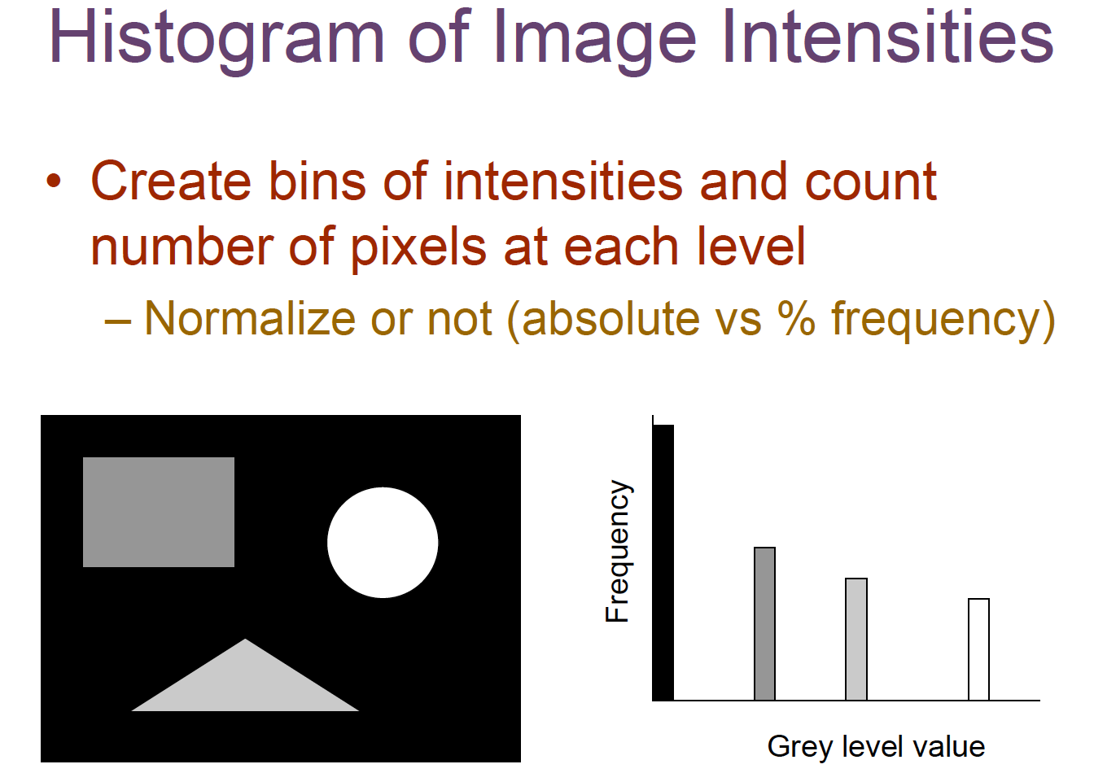
Histogram Application

Slide 46
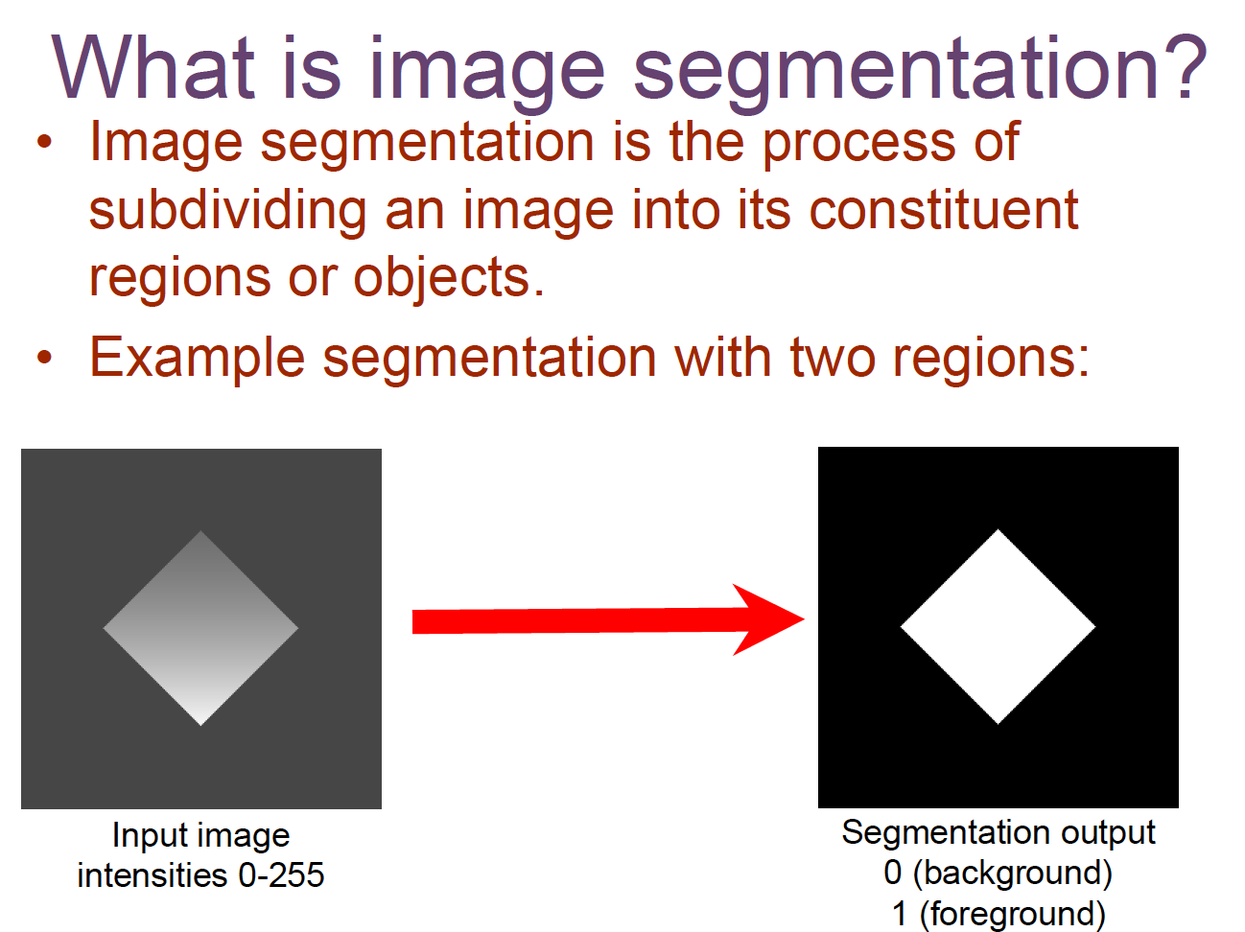
Histogram Application

Slide 47
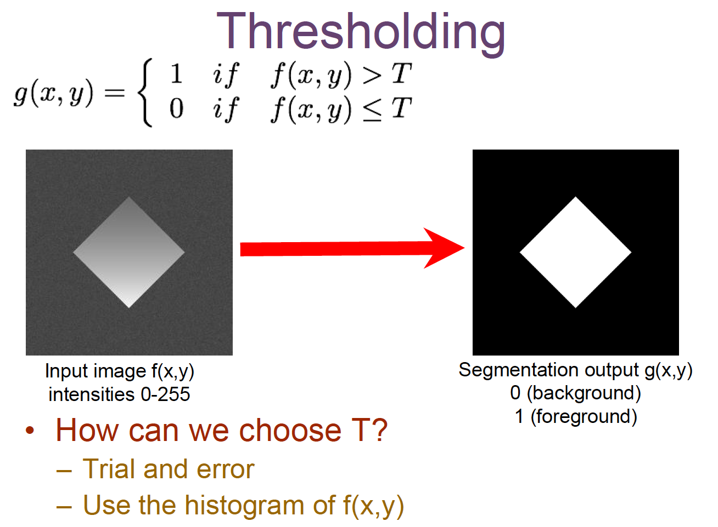
Histogram Application

Slide 48
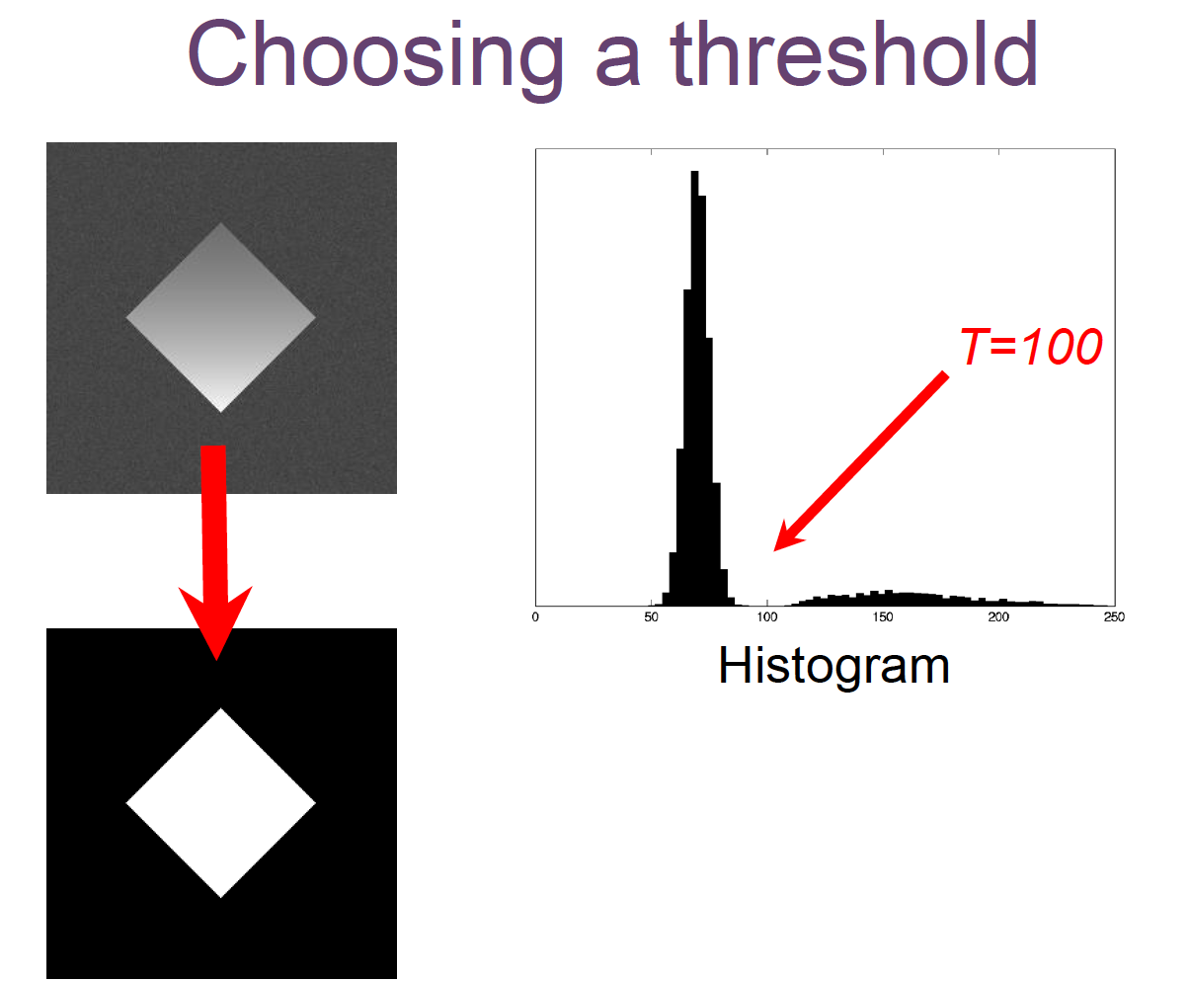
Histogram Application

Slide 49
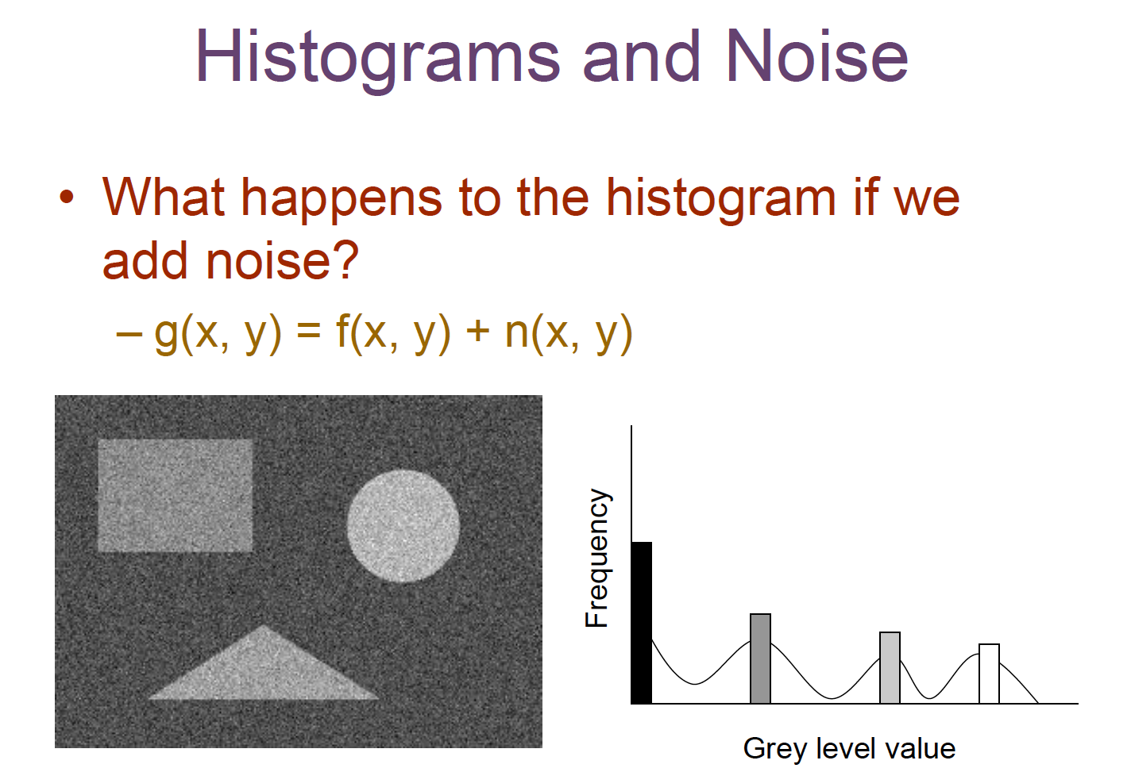
Histogram Application

Slide 50
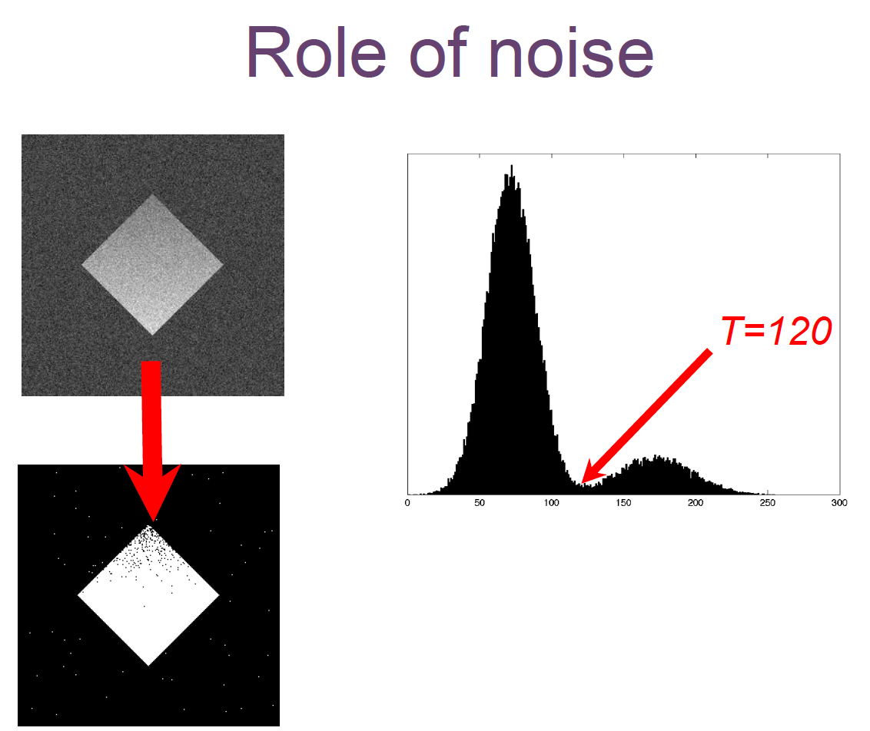
Histogram Application

Slide 51
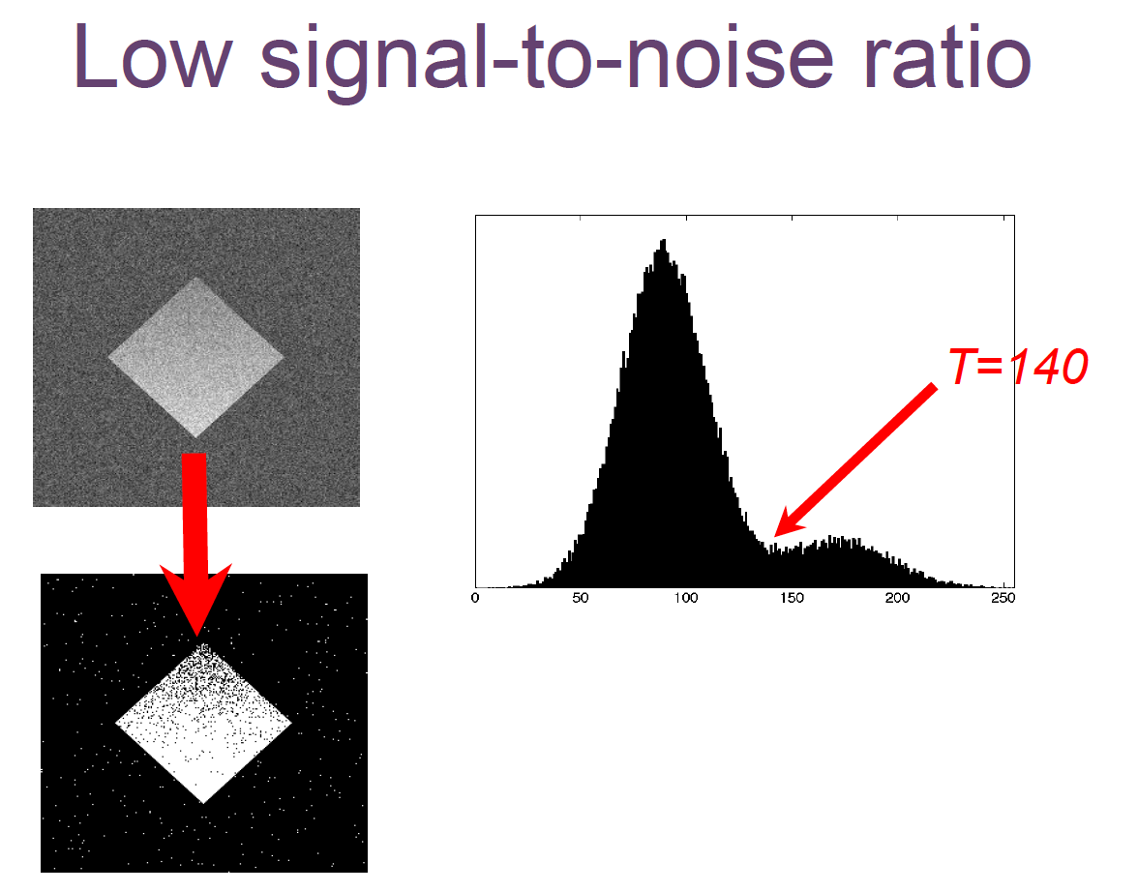
Histogram Application

Slide 52
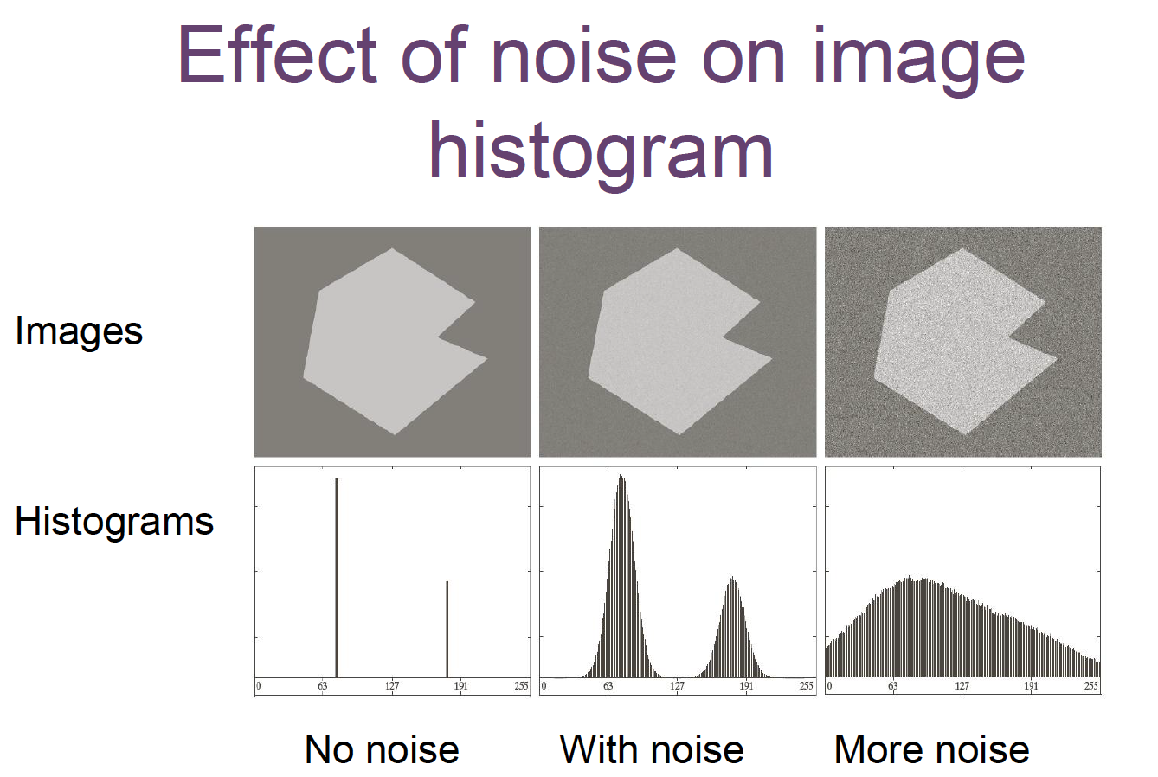
Histogram Application

Slide 53
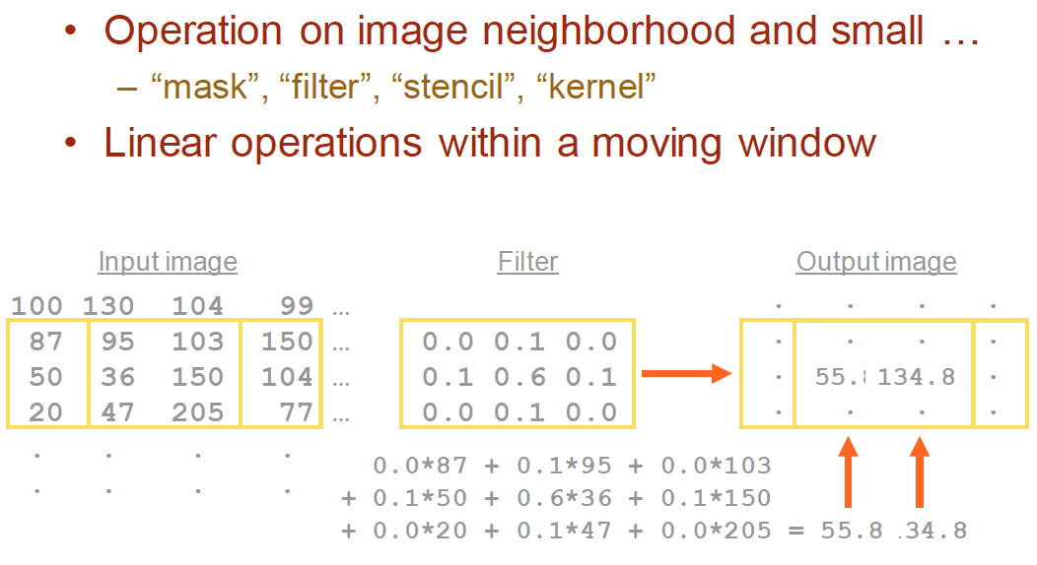
Special filtering

Slide 54
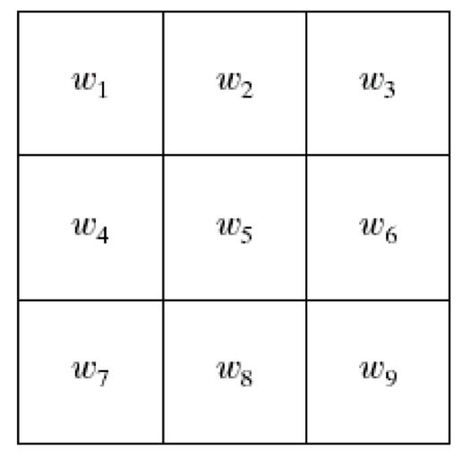
Spatial filtering
General Spatial filter

Slide 55
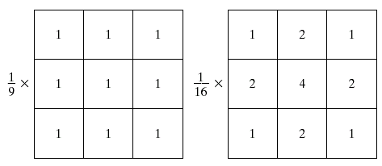
Spatial filtering

Slide 56
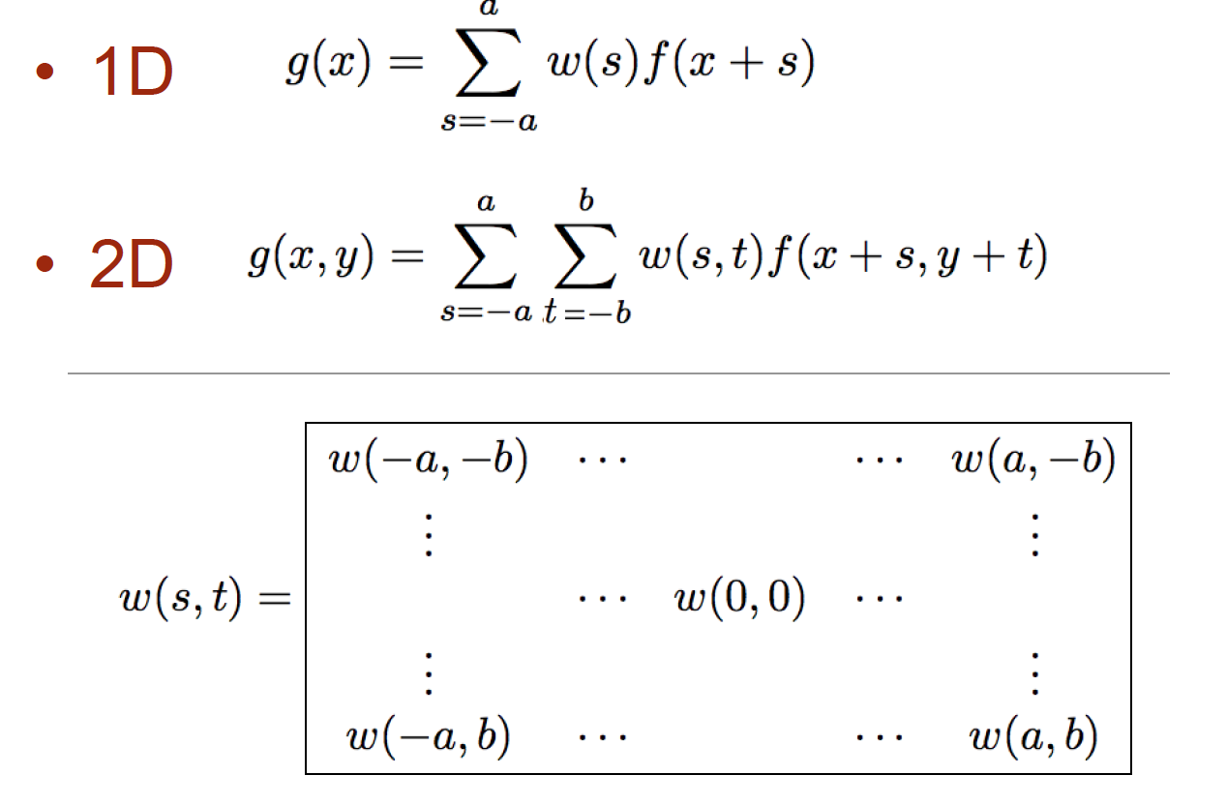
Spatial filtering
Correlation

Slide 57
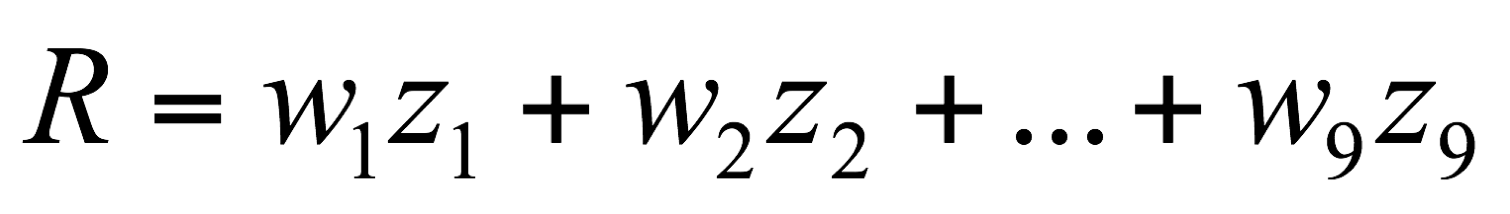
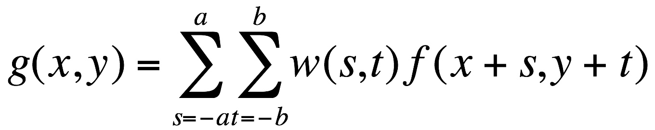
Spatial filtering
a=(m-1)/2 and b=(n-1)/2,
m x n (odd numbers)
For x=0,1,…,M-1 and y=0,1,…,N-1
The basic approach is to sum products between the mask coefficients and the intensities of the pixels under the mask at a specific location in the image:
(for a 3 x 3 filter)

Slide 58
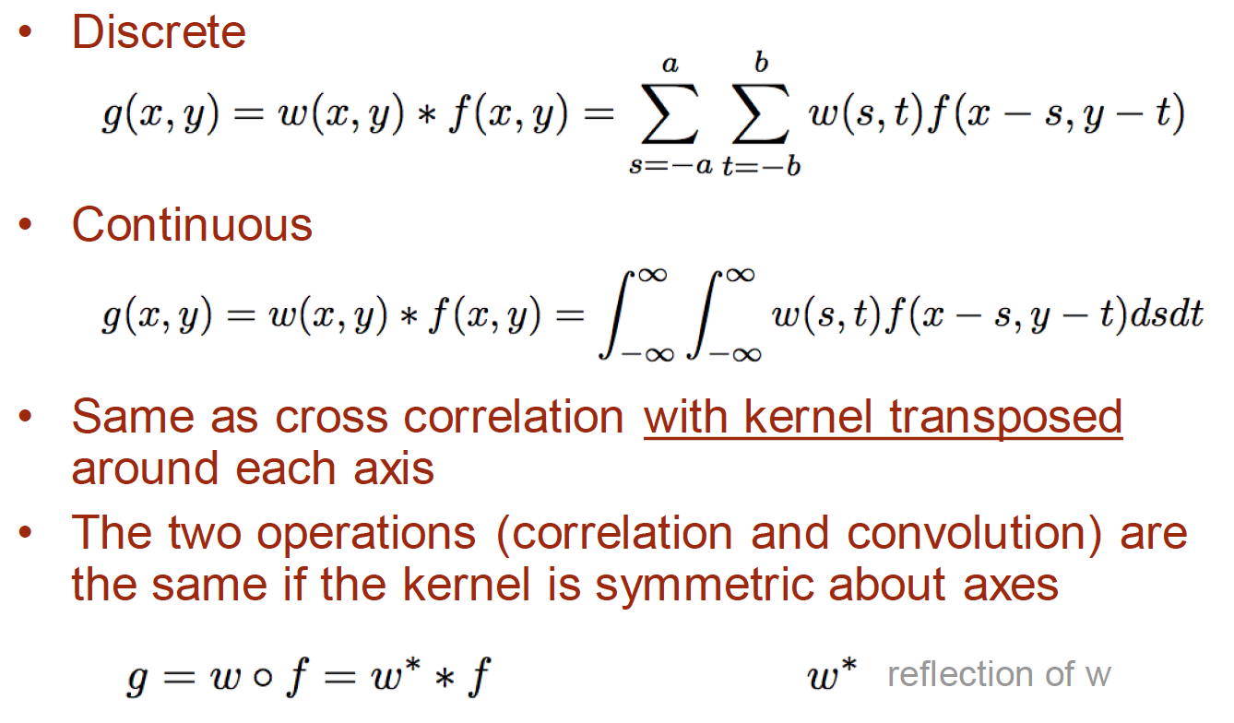
Spatial filtering
Convolution

Slide 59


Slide 60

Correlation
Convolution

Slide 61

Spatial filtering

Slide 62

Spatial filtering

Slide 63

Spatial filtering – Image Smoothing

Slide 64

Spatial filtering – Image Smoothing

Slide 65

Spatial filtering – Image Smoothing

Slide 66
Spatial filtering – Median Filter
Median filtering (nonlinear)
Used primarily for noise reduction (eliminates isolated spikes)
The gray level of each pixel is replaced by the median of the gray levels in the neighborhood of that pixel (instead of by the average as before).

Slide 67
Spatial filtering – Median Filter

Slide 68

Spatial filtering – Median Filter

Slide 69

Spatial filtering – Median Filter

Slide 70

Spatial filtering – Median Filter

Slide 71
Spatial filtering – Gaussian

Slide 72


Spatial filtering – Gaussian

Slide 73
Spatial filtering – Gaussian

Slide 74



Spatial filtering – Image Sharpening
First derivative “gradient”
Second derivative

Slide 75


Spatial filtering – Image Sharpening
First derivative “gradient”
Second derivative

Slide 76
Spatial filtering – Image Sharpening
Laplacian filter

Slide 77
Spatial filtering – Image Sharpening
a b
c d

Slide 78

Spatial filtering – Image Sharpening

Slide 79
Spatial filtering – Image Sharpening
General way of image sharpening

Slide 80


Spatial filtering – Sobel Filter (edge detection)
The Sobel filter uses two 3 x 3 kernels. One for changes in the horizontal direction, and one for changes in the vertical direction. The two kernels are convolved with the original image to calculate the approximations of the derivatives. If we define Gx and Gy as two images that contain the horizontal and vertical derivative approximations respectively, the computations are:
Where A is the original source image.
At each pixel in the image, the gradient approximations given by Gx and Gy are combined to give the gradient magnitude, using:

Slide 81






Spatial filtering – Sobel Filter (edge detection)

